Slide 1
Solar Energy System, Solar Radiation, Availability, Measurement And Estimation, Solar Thermal Conver
SlideMake.com

Slide 2
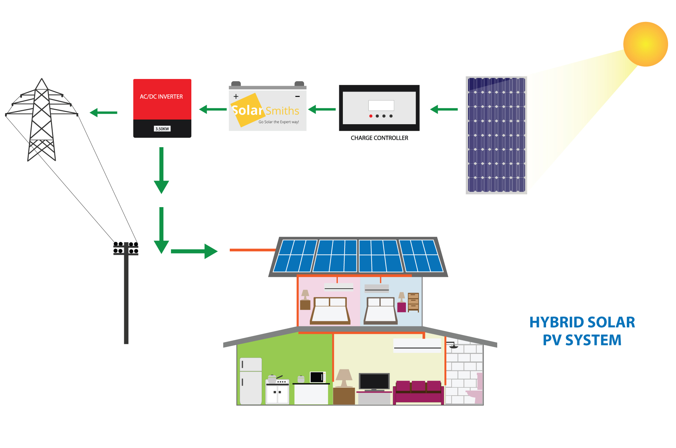
Introduction to Solar Energy System
Solar energy system harnesses the power of the sun to generate electricity or heat.
It is a renewable and clean source of energy.
Solar energy systems can be classified into two types: photovoltaic (PV) and solar thermal.
Notes:
Image source: https://www.solarsmiths.com/blog/knowledge/introduction-to-solar-power-system/

Slide 3
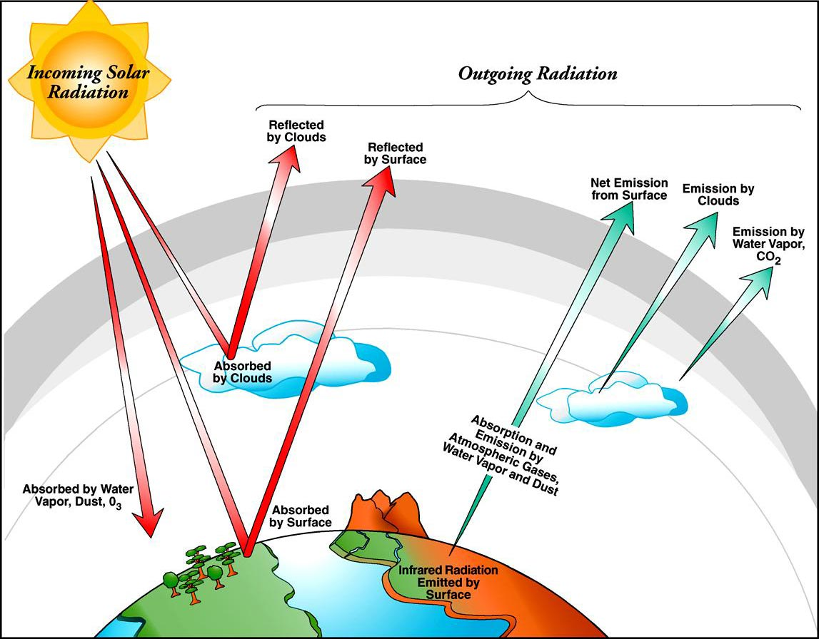
Solar Radiation
Solar radiation refers to the electromagnetic energy emitted by the sun.
It includes visible light, infrared, and ultraviolet rays.
Solar radiation is the primary source of energy for solar energy systems.
Notes:
Image source: https://scitechdaily.com/science-made-simple-what-is-atmospheric-radiation/

Slide 4
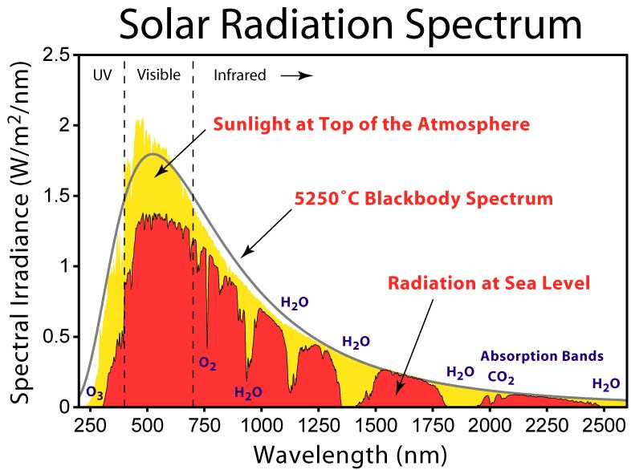
Availability of Solar Radiation
Solar radiation is available everywhere on Earth, although the intensity varies depending on geographical location and time of the day.
Areas closer to the equator receive more solar radiation compared to polar regions.
Cloud cover, atmospheric conditions, and seasonal variations also affect the availability of solar radiation.
Notes:
Image source: http://synergyfiles.com/2016/05/solar-radiation/

Slide 5
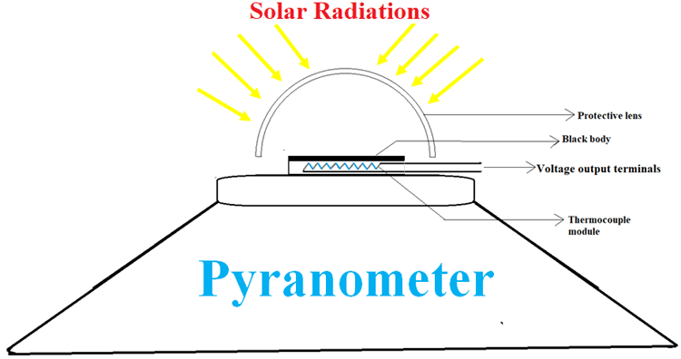
Measurement of Solar Radiation
Solar radiation is measured using instruments called pyranometers.
Pyranometers measure the total amount of solar radiation reaching a specific surface area over a given time period.
The unit of measurement for solar radiation is watts per square meter (W/m²).
Notes:
Image source: https://circuitdigest.com/tutorial/solar-radiation-measurement-methods-using-pyrheliometer-and-pyranometer

Slide 6
Estimation of Solar Radiation
Solar radiation can be estimated using satellite data and models.
Solar irradiance models utilize factors such as latitude, longitude, elevation, and atmospheric data to estimate solar radiation.
These estimates help in designing and optimizing solar energy systems.
Notes:
Image source: https://www.researchgate.net/figure/Estimation-of-daily-solar-radiation-on-the-solar-dish-South-facing-Tilted-30-during_fig4_305811492

Slide 7
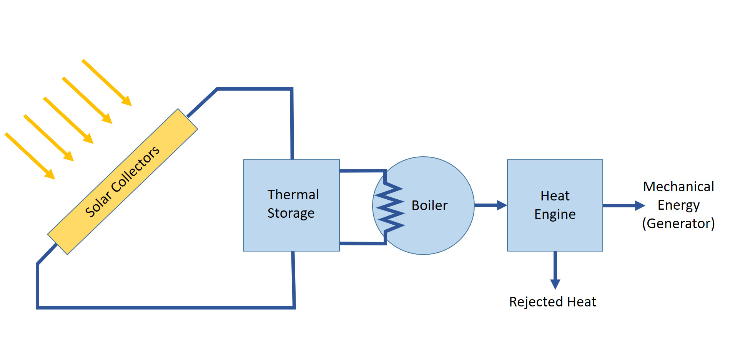
Solar Thermal Conversion
Solar thermal conversion refers to the process of converting solar radiation into heat energy.
Solar thermal collectors, such as flat plate collectors and evacuated tube collectors, absorb solar radiation and transfer it to a fluid.
The heated fluid can be used for various applications like water heating, space heating, and industrial processes.
Notes:
Image source: https://ar.inspiredpencil.com/pictures-2023/solar-system-model-mechanical-schematic

Slide 8
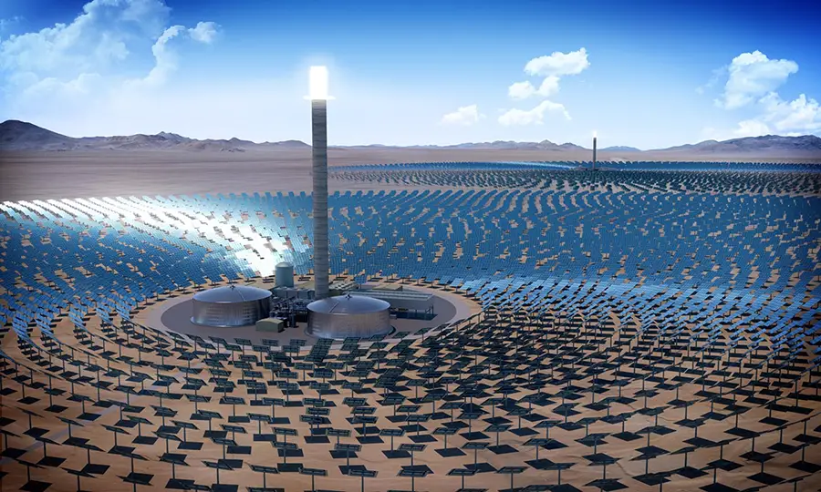
Solar Thermal Power Plants
Solar thermal power plants generate electricity by using concentrated solar power (CSP) technology.
CSP systems use mirrors or lenses to concentrate solar radiation onto a receiver, which heats a fluid to produce steam.
The steam drives a turbine connected to a generator, producing electricity.
Notes:
Image source: https://electricalacademia.com/renewable-energy/concentrated-solar-power-csp-technologies/

Slide 9
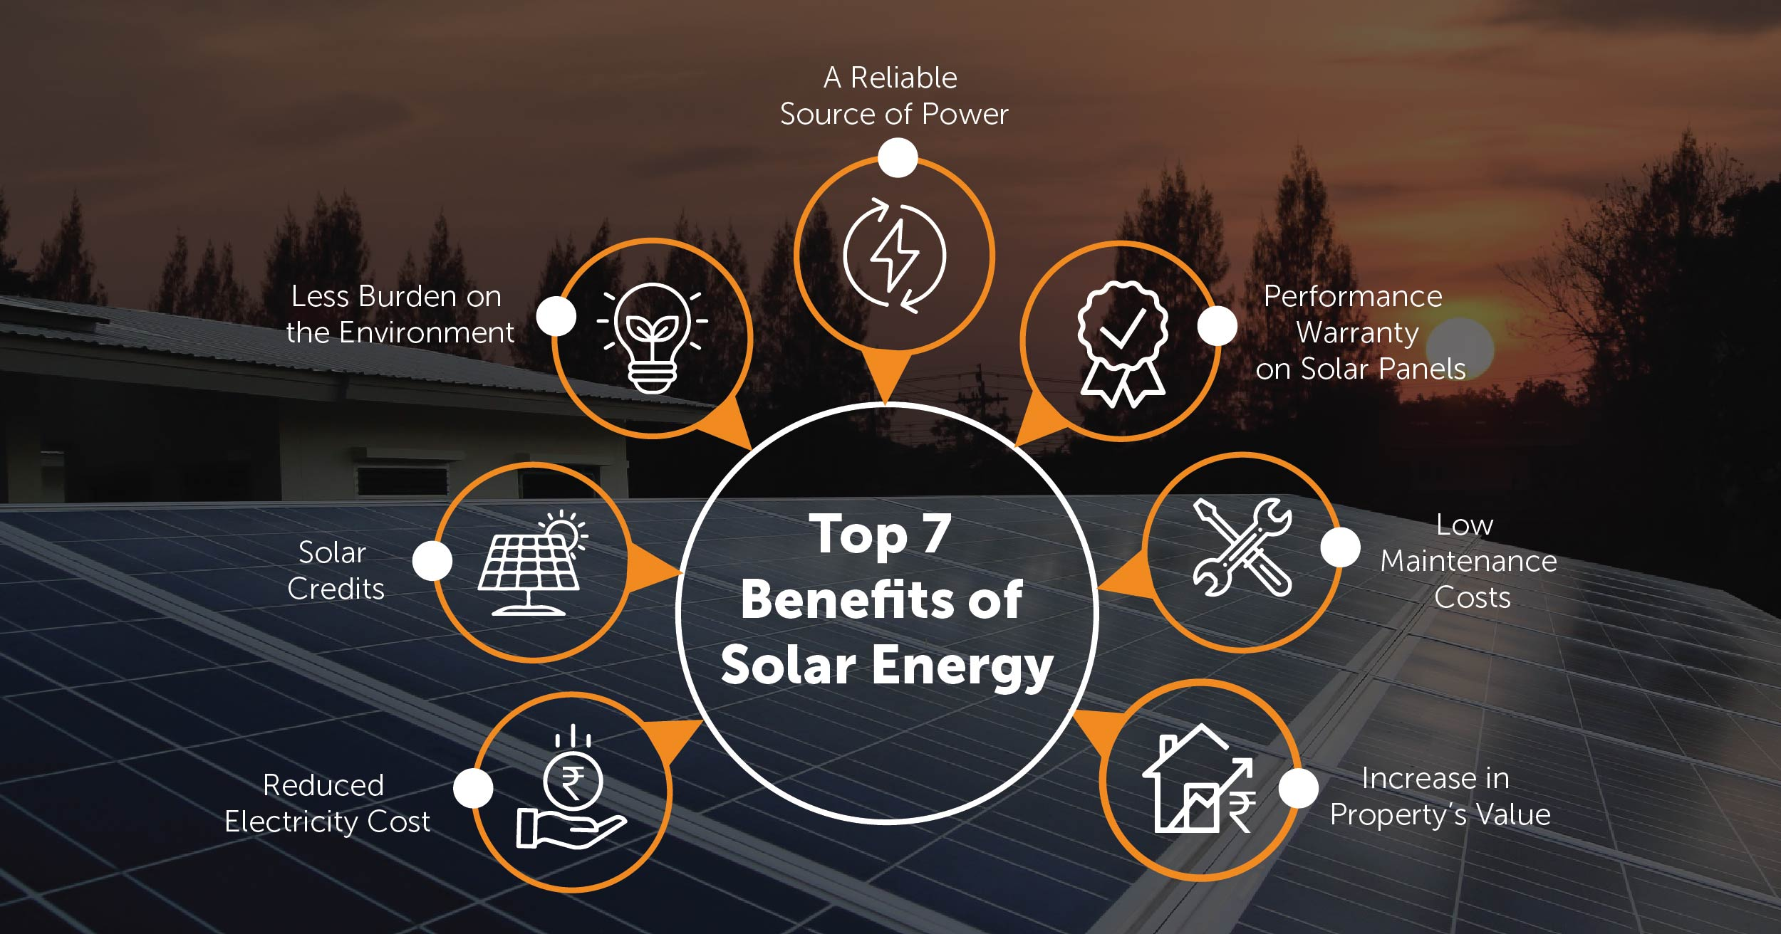
Benefits of Solar Energy Systems
Solar energy systems reduce reliance on fossil fuels and mitigate greenhouse gas emissions.
They contribute to energy independence and security.
Solar energy is inexhaustible and abundant, making it a long-term sustainable solution.
Notes:
Image source: https://homescape.solar/blog/solar-energy-benefits/

Slide 10
Challenges of Solar Energy Systems
The initial cost of installing solar energy systems can be high.
Solar energy production is intermittent and depends on weather conditions.
Integration with existing power grids and storage of excess energy are challenges that need to be addressed.
Notes:
Image source: https://modernize.com/solar/panel-cost-calculator

Slide 11
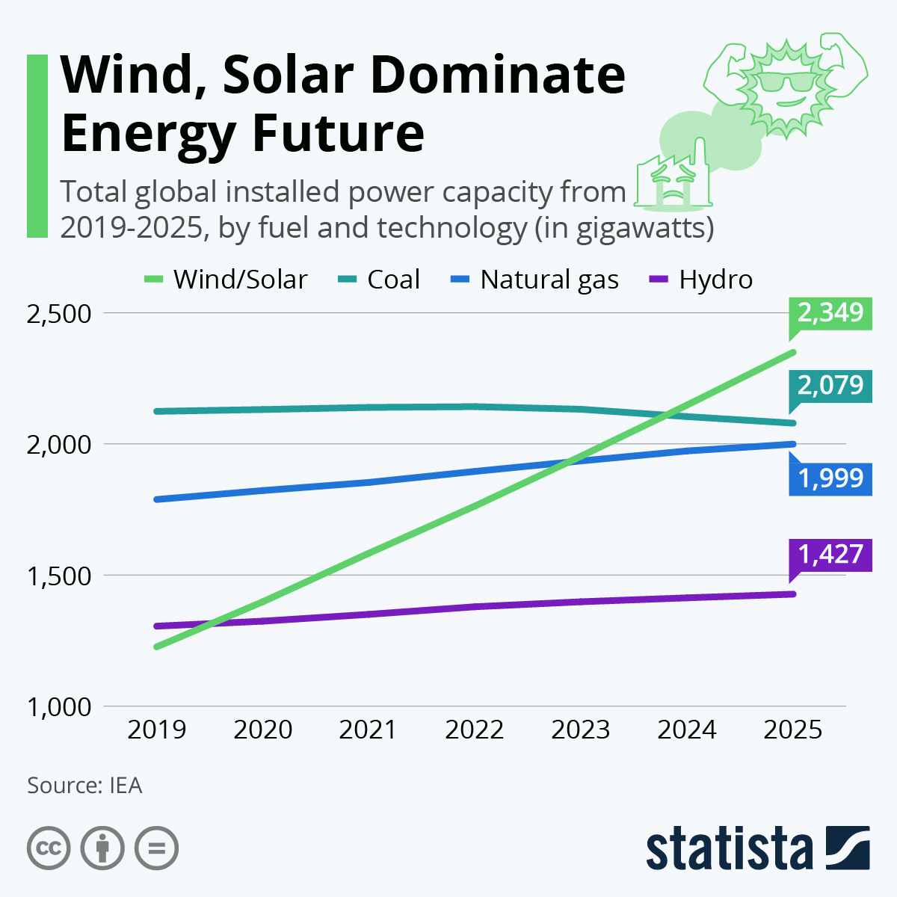
Future Outlook of Solar Energy
The cost of solar energy systems has been steadily decreasing, making it more accessible.
Advances in energy storage technologies will enable better utilization of solar energy.
Continued research and development will lead to more efficient solar energy systems.
Notes:
Image source: https://moreenergy.org/wind-solar-dominate-energy-future/

Slide 12
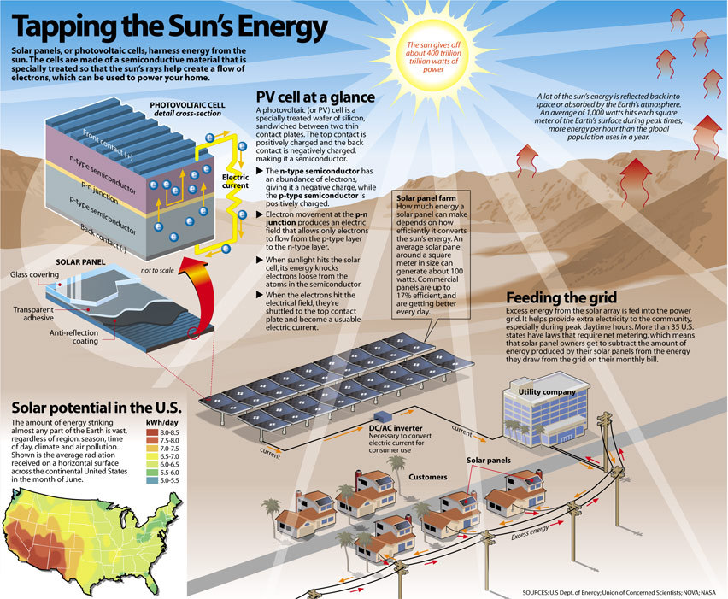
Conclusion
Solar energy systems harness the power of solar radiation to generate electricity or heat.
Solar radiation is available everywhere but varies in intensity.
Measurement and estimation of solar radiation are crucial for the design and optimization of solar energy systems.
Notes:
Image source: https://infographicworld.com/solar-energy-harnessed/

